Slide 1
BIG MART SALES PREDICTION USING MACHINE LEARNING
INTRODUCTION
Big Mart is a big supermarket chain, with stores all around the country and its current board set out a challenge to all Data Scientist out there to help them create a model that can predict the sales, per product, for each store to give accurate results. Big Mart has collected sales data from the year 2013, for 1559 products across 10 stores in different cities.
With this information the corporation hopes we can identify the products and stores which play a key role in their sales and use that information to take the correct measures to ensure success of their business.
OBJECTIVES
i. The objective of this framework is to predict the future sales from given data of the previous year's using Machine Learning Techniques.
ii. Another objective is to conclude the best model which is more efficient and gives fast and accurate result.
iii. To find out key factors that can increase their sales and what changes could be made to the products and make several marketing plans.

Slide 2
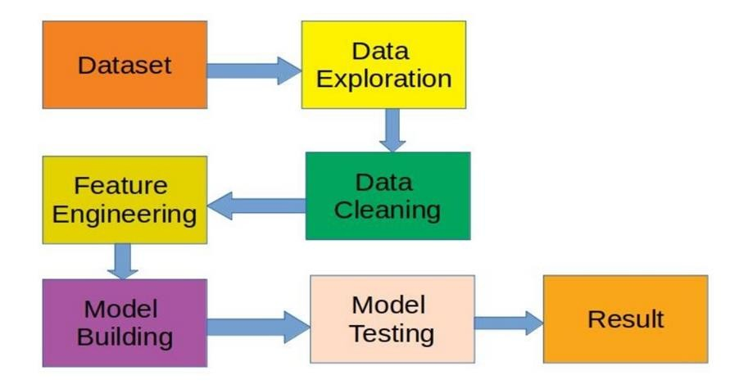
Steps:

Slide 3
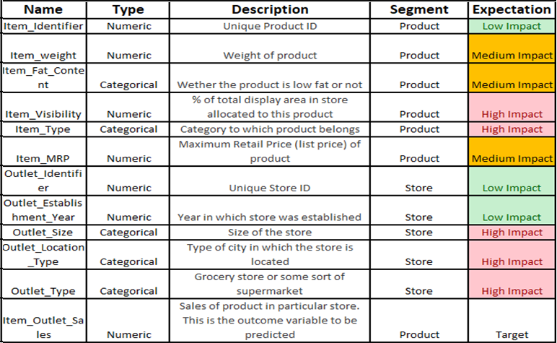
1. Dataset
Here the Dataset file shape is (8523, 12)

Slide 4
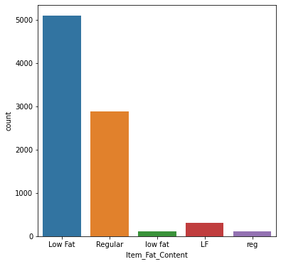
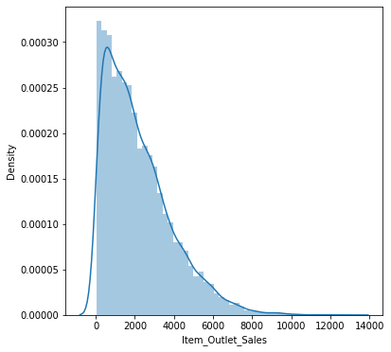
2. Data Exploration
In this phase useful information about the data has been extracted from the dataset. That is trying to identify the information from hypotheses vs available data.
1)Which shows that the attributes Item weight (1463, float64) and Outlet size(2410,object) has the missing values.
2) And secondly , we observe that the Outlet size column is of Object Datatypes.
3. Data Visualization
1)We will be Plotting the Distribution chart for Numerical features and the Bar chart for categorical features.
2)As below in Chart 1, we observe that In the Categorical feature Item_Fat_Content some of them are misspelled as reg instead of ’Regular’ and low fat, LF instead of Low Fat. So , we need to Preprocess the data here.
3) And in the Chart 2 , We see that the Target Analysis Item_Outlet_Sales is one sided distribution which is not a normal distribution and the sales are in the range of 2000-10000

Slide 5
4. Data Cleaning
It was observed from the previous section that the attributes Item Weight and Outlet Size has missing values. In our Project problem :
1) Item Weight missing values, we will replace by Mean of that particular column.
2) Outlet Size missing value we will replace by the Mode of that column.
. Item_Identifier 0
Item_Weight 1463
Item_Fat_Content 0
Item_Visibility 0
Item_Type 0
Item_MRP 0
Outlet_Identifier 0
Outlet_Establishment_Year 0
Outlet_Size 2410
Outlet_Location_Type 0
Outlet_Type 0
Item_Outlet_Sales 0
dtype: int64

Slide 6
5. Feature Engineering
1) Here we will Transforming object data types into vector. As the raw data doesn’t come to us as feature vectors .So, we need do the Feature engineering for Feature vectors.
2) Below are the Categorical Features which needs to be transformed into feature vectors.
Item Identifier
Item_Fat_Content
Item Type
Outlet Identifier
Outlet Size
Outlet_Location_Type
Outlet Type
6. Model Building
After completing the previous phases, the dataset is now ready to build proposed model. Once the model is build it is
used as predictive model to forecast sales of Big Mart. So, we will predict using several model building algorithms.
Conclusion
We see RandomForestRegressor and DecisionTreeRegressor proves to be beneficial which gives us 61% accuracy than
Simple linear regression model
L1 and L2 regularization and
XGBoost Regressor

